Slide 1
Quote Generator
Yashaswini Rao AV.EN.U4AIE22151

Slide 2
Project Aim
To develop a full-stack Random Quote Generator web application that allows users to register, log in, and dynamically generate inspirational quotes using an external API. The project integrates a responsive Bootstrap-based frontend, interactive JavaScript and jQuery functionalities for validation and UI effects, and a Flask backend with SQLite database for user management. Demonstrating end-to-end web development and deployment on Render.

Slide 3
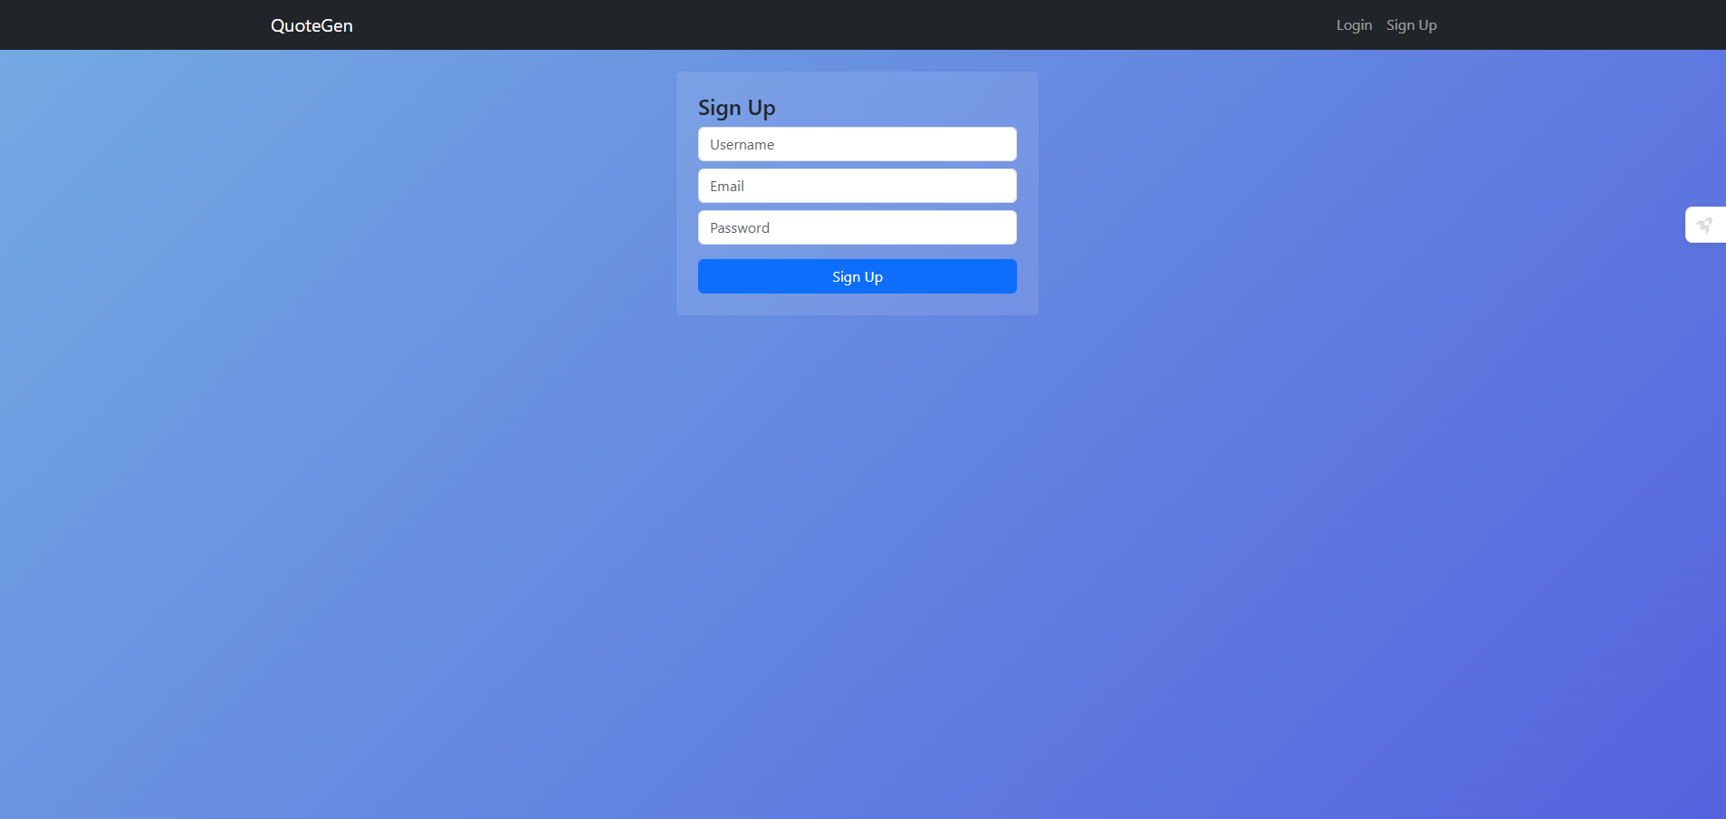
Sign Up page

Slide 4
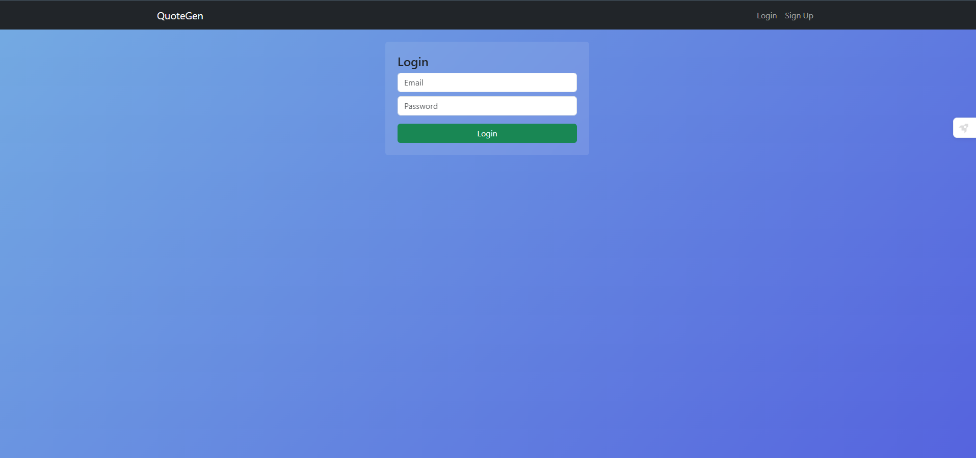
Login Page

Slide 5
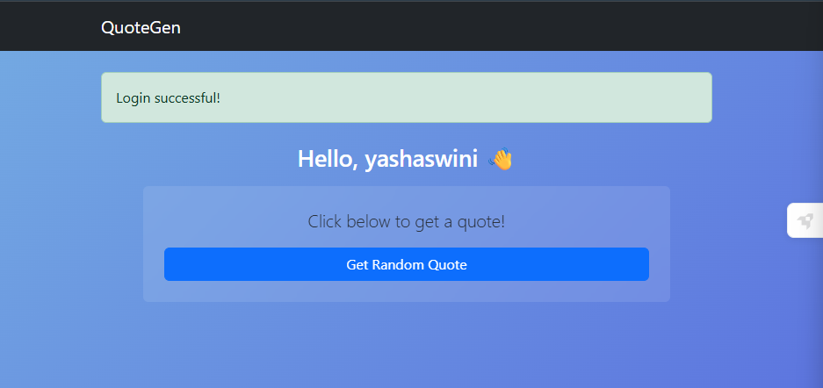
Functionality

Slide 6
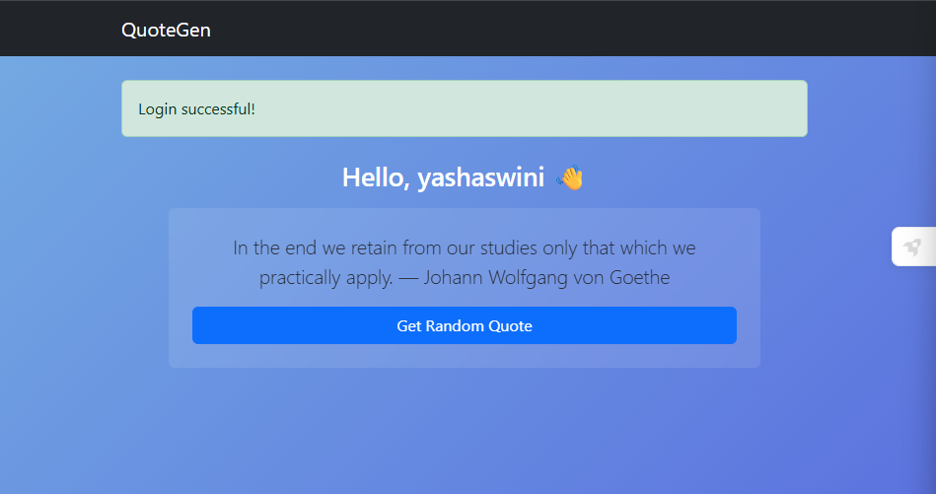
Functionality-Randomly Generated Quotes

Slide 7
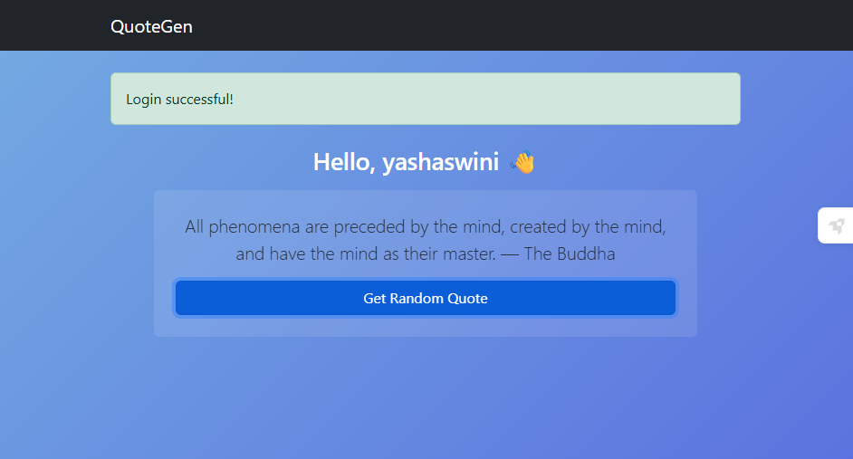

Slide 8
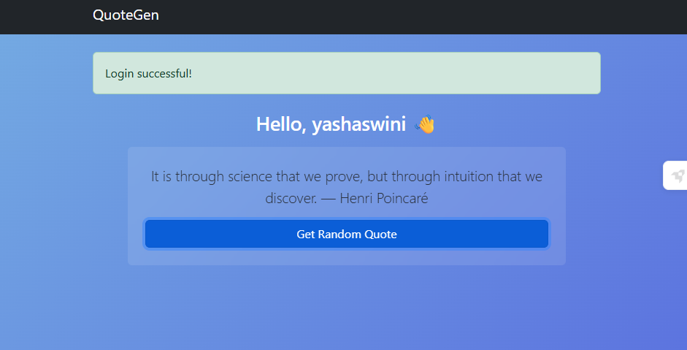

Slide 9
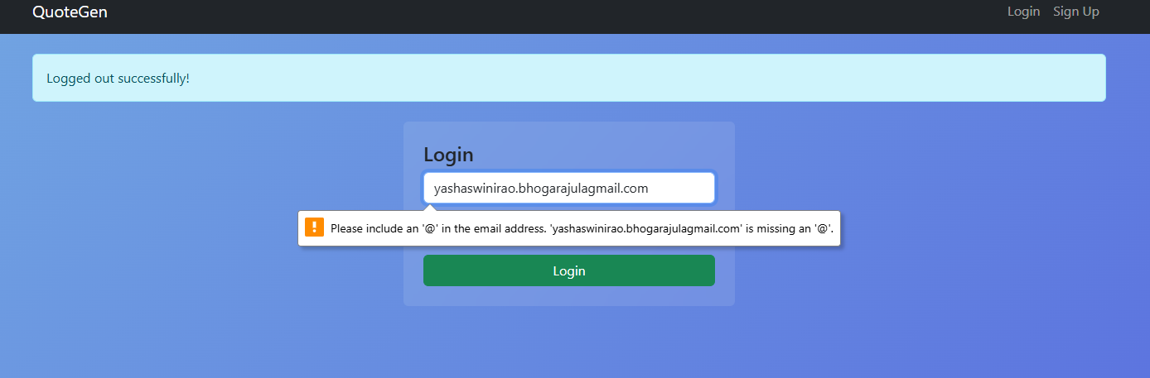
Performs Validations

Slide 10
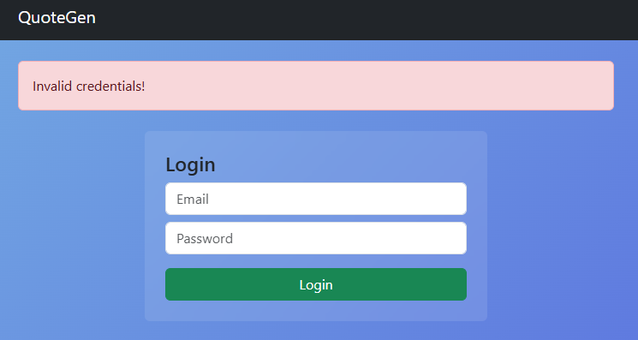
Performs validations

Slide 11
Timestamps

Slide 12
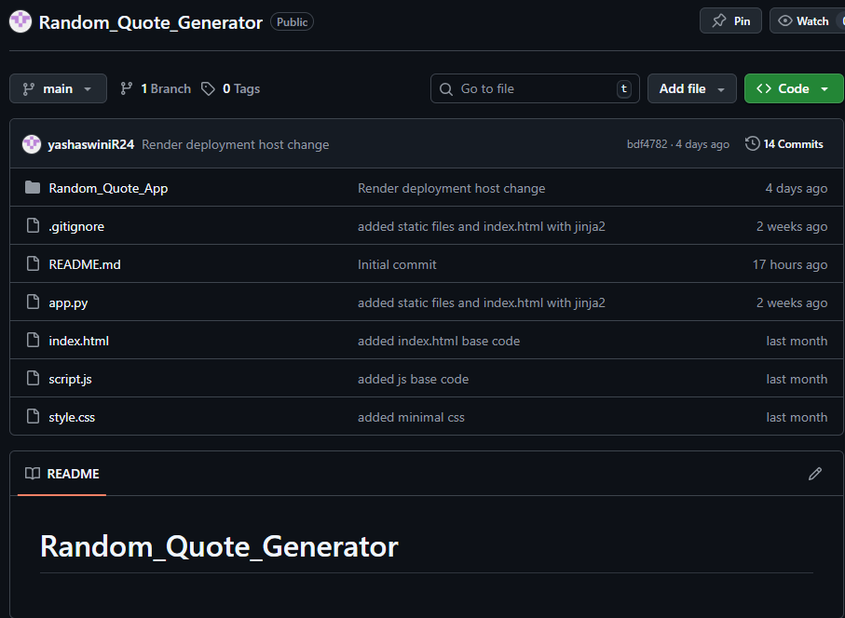

Slide 13
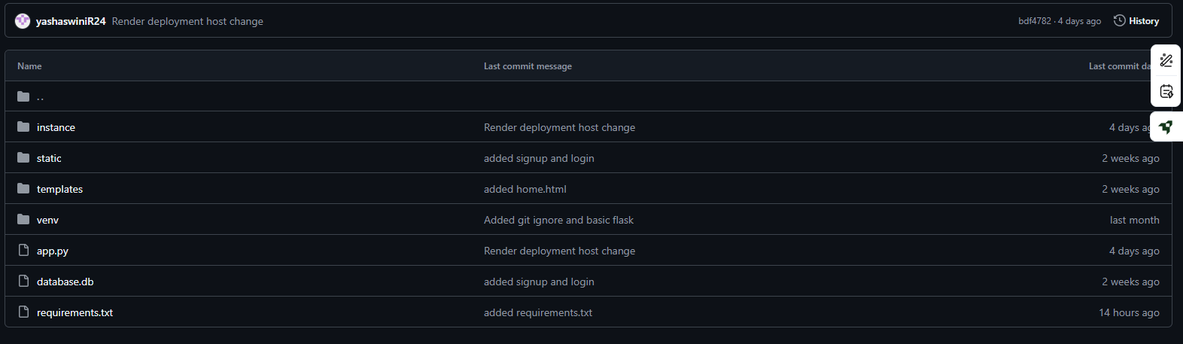

Slide 14
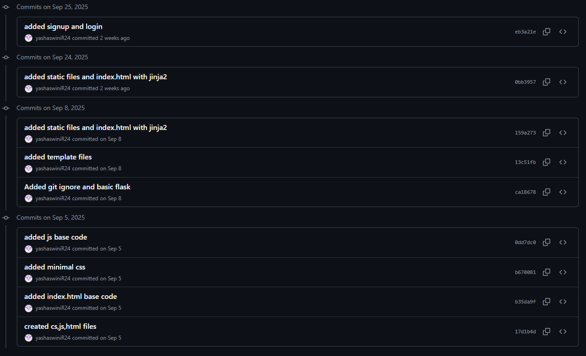

Slide 15
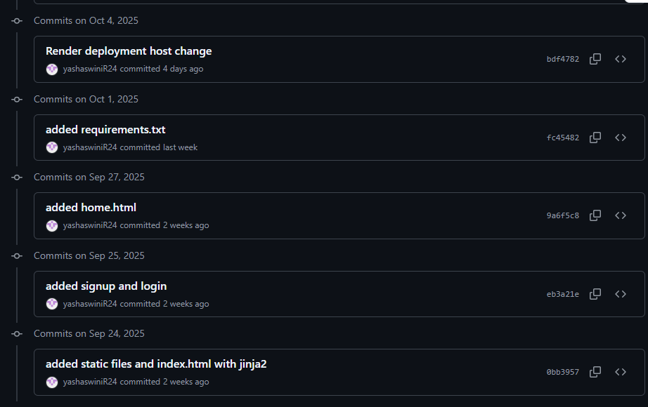

Slide 16
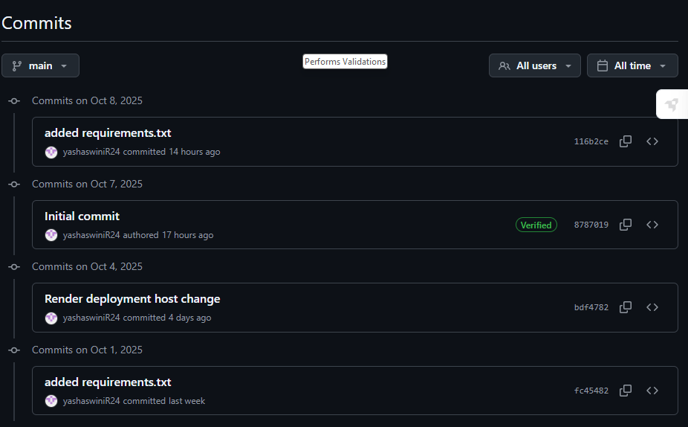

Slide 17
Github Link:https://github.com/yashaswiniR24/Random_Quote_Generator/commits/main/
Website Link: QuoteGen

